Slide 1

Projection of a Point on a Line and Applications: Simple Linear Regression

Slide 2
Members
Madhu Donipati(MIT2021116)
Chandrakishor Singh(MIT2021117)
Dablu Chauhan(MIT2021115)

Slide 3
Introduction
Projections and projection matrices play an important part in machine learning, signal processing, and optimization in general.
Suppose the line l is defined by two points p0 and p1. Let q be another point, which we must assume is not on l . The point p on l that is closest to q is called the projection of q on l.
In General, projection is an operation that moves points into a subspace.
A projection matrix contains the information and provides a means of identifying exceptional data points.

Slide 4
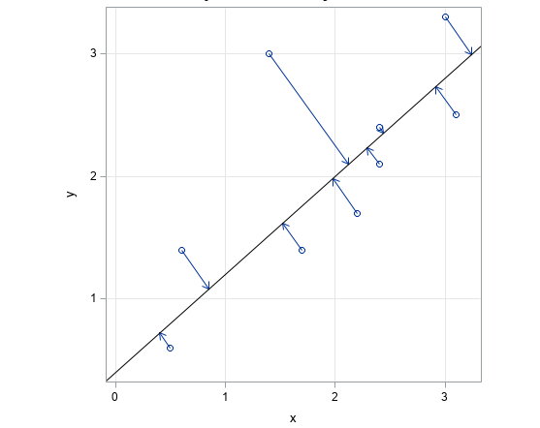
Projection of points onto a line

Slide 5
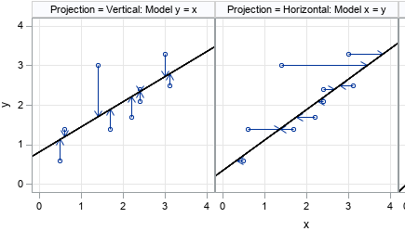
How Projection is related to Linear Regression?
Graphs showing the geometry of linear regression when we regress Y onto X and vice versa

Slide 6
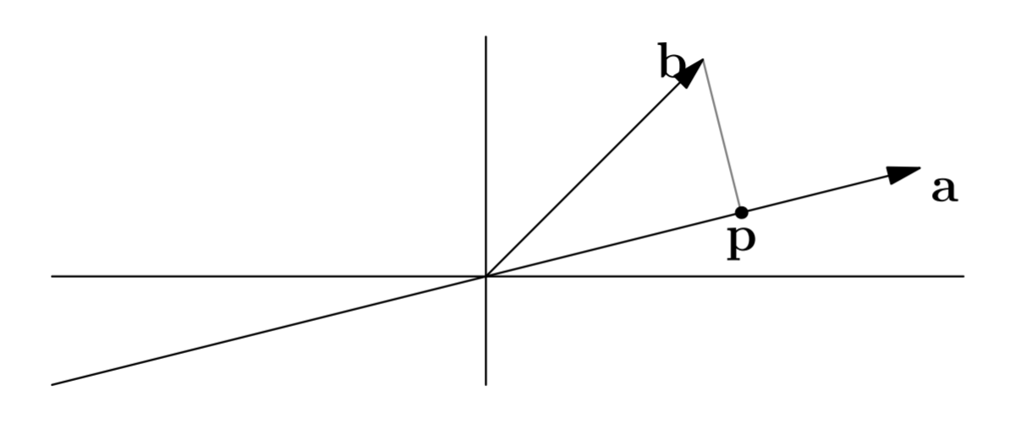
MATHEMATICAL PRELIMINARIES
1.Projection:
Projections minimize the distance between points and subspace. There are many projection methods like orthogonal projection and perspective projection.
Consider a vector b and a line determined by a vector a, we can find the point on the line that is closest to b as follows:

Slide 7
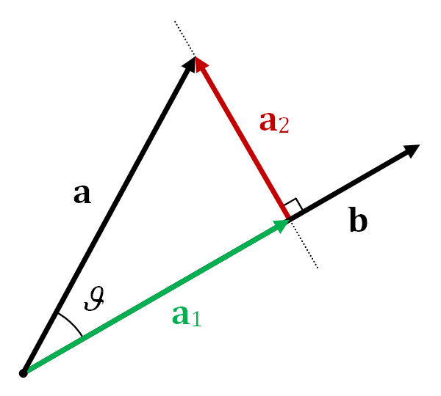
Projection of two vectors

Slide 8
Now, How do we identify the point on the line a that is closest to b ?
This is where the concept of projection comes into play.
Above Figure represents the point closest to b on the line determined by a. We can see from the above Figure that this closest point p is at the intersection formed by a line through b that is orthogonal to a.
If p as an approximation of b, then the length of the error in that approximation is e = b − p.
Using linear algebra, it’s easier to find p, rather than using trigonometry or calculus.
Since p lies on the line through a, we know p = xa for some number x.

Slide 9
We also know that a is perpendicular to e = b – xa:
a^{T}(b − xa) = 0
xa^{T}a = a^{T}b
x = a^{T}b / a^{T}a
and p = ax
Doubling b doubles p. Doubling a does not affect p.

Slide 10
2. Projection Matrix:
We’d like to write this projection in terms of a projection matrix P: p = Pb.
ax = Pb
P=ax/b
So, the projection matrix P is,
P = aa^{T} / a^{T}a
The matrix P is called the projection matrix, using which you can project any vector onto the vector a by multiplying with matrix P. A projection matrix also called as hat matrix.
Note : aa^{T} is a 3 x 3 matrix, not a number. And matrix multiplication is not commutative.
Using the diagonal elements of the projection matrix, we can identify data points which may have an unusual impact on the results of fitting the linear model.

Slide 11
Properties of Projection Matrix:
• Rank of P is 1
• P is symmetric
• P ² b = P b because the projection of a vector already on the line through a is just that vector.

Slide 12
Linear Regression

Slide 13
Regression
Technique used for the modeling and analysis of numerical data
Exploits the relationship between two or more variables so that we can gain information about one of them through knowing values of the other
Regression can be used for prediction, estimation, hypothesis testing, and modeling causal relationships

Slide 14
Linear Regression as a Projection Problem
In linear regression, our goal is to find a line of best fit over the given data points
Thus, to it is required to minimize the square of the distance between a point and the required line.
This can be seen as the problem of finding the projection of the data points onto the line such that the error is as minimum as possible

Slide 15
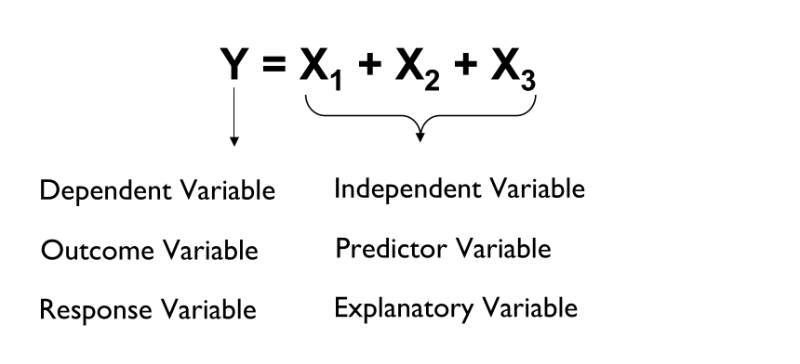
Regression: Terminologies

Slide 16
Regression: Assumptions
Dependent variable is a continuous variable
Exists a Linear relationship b/w dependent variable and independent variable
No Multicollinearity between Independent variables
Homoscedasticity

Slide 17
Regression vs Correlation
A scatter diagram can be used to show the relationship b/w 2 variables
Correlation analysis is used to measure the strength of the association between 2 variables
Correlation is only concerned with the strength of relationship
No causal effect is implied by correlation

Slide 18
Regression: Simple Linear Regression
Only one independent variable, X
Relationship b/w X and Y is described using a linear function
Changes in Y are assumed to be caused by changes in X

Slide 19
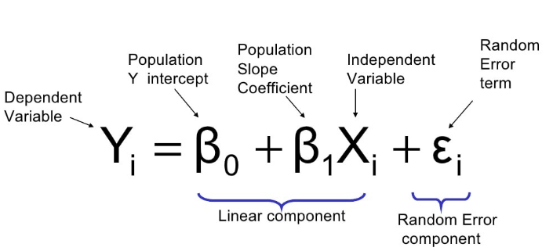
Simple Linear Regression Model

Slide 20
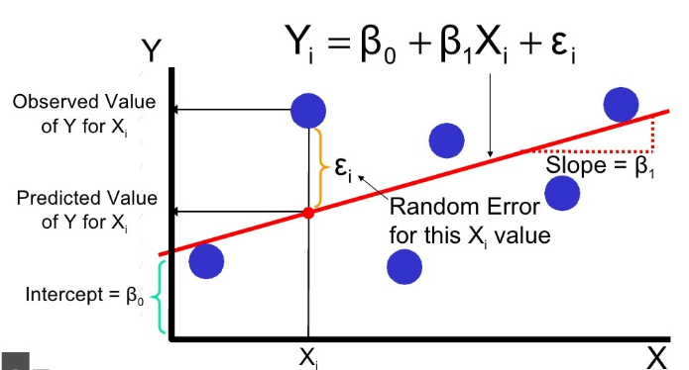
Simple Linear Regression Model(Cont.)

Slide 21
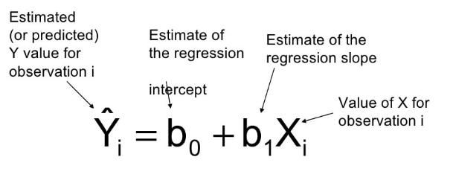
Simple Linear Regression Model: Prediction Line
The simple linear regression equation provides an estimate of the population regression line

Slide 22
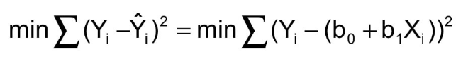
Least Square Method
b₀ and b₁ are obtained by finding the values of b0 and b1 that minimizes the sum of the squared differences between Y and Y’

Slide 23
Interpretation of Slope and Intercept
b₀ is the estimated avg value of Y when the value of X is zero
b₁ is the estimated change in avg value value of Y as a result of a one-unit change in X

Slide 24
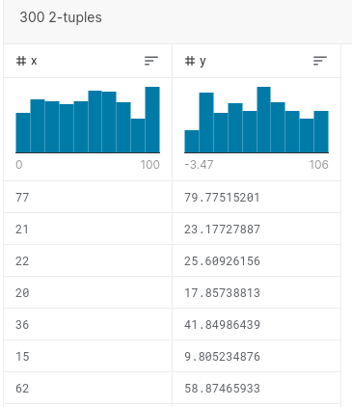
Simple Linear Regression: Example
A dummy dataset from Kaggle is used
It has 2 columns. X and Y.
Both are just random values with no physical significance

Slide 25
Simple Linear Regression: Training the model
Python with Jupyter notebook, pandas for data manipulation and matplotlib for plotting is used.
Model is trained on X and Y values of dataset
During this process, values of m and c are estimated.
Our function linear_reg() iteratively minimizes the error using gradient descent.

Slide 26
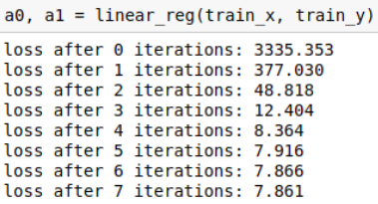
Simple Linear Regression: Training the model(Cont.)
After each iteration, loss(error) is decreasing

Slide 27
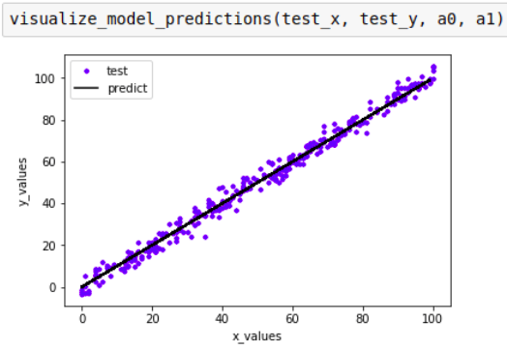
Simple Linear Regression: Final Model
We obtain below final model

Slide 28
Application
1). Principal component analysis (PCA)
Principal component analysis (PCA) is a fundamental tool in unsupervised learning and data analysis that finds the low-dimensional linear subspace that minimizes the mean squared error between the original data and the data projected onto the subspace.
PCA is frequently used for dimensionality reduction, feature extraction, and as a pre-processing step for learning and recognition tasks such as classification.
PCA is the most widely used tool in exploratory data analysis and in machine learning for predictive models.

Slide 29
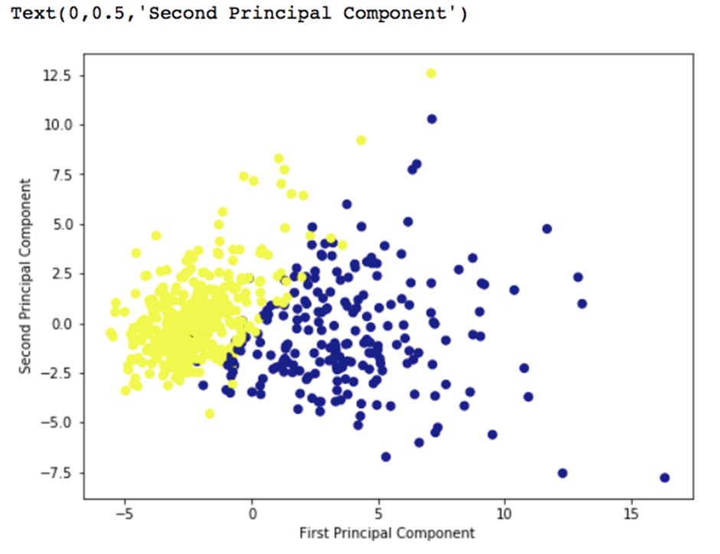

Slide 30
2). Least Square problems
In real life, there might be times when we want to find a “best-fitting” curve to a set of some given points.
For example, people might want to find the relationship between the lean body mass of human bodies and their muscle strength or analyze how the housing price changes by years to obtain an estimation of the price in the future.

Slide 31
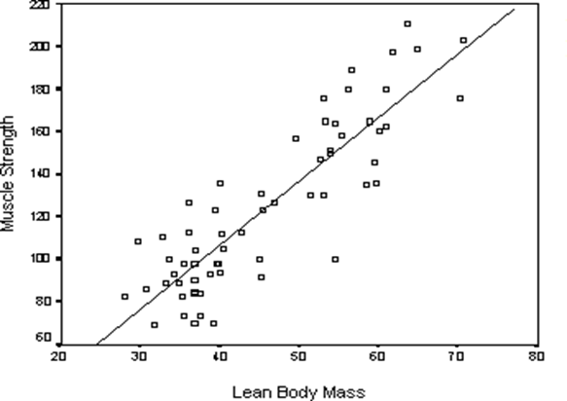
Least square solution of the relation between human lean body mass and muscle strength

Slide 32
3).CAD/CAM APPLICATION:-
Orthogonal projection is an important process in geometric modeling, computer-aided design, and computer graphics.
It is one of the most critical operations in computer-aided geometric design and applications. Orthogonal projection is used as a component for the fitting of geometric features to 2D or 3D point clouds.
Orthogonal projection is used as a component for the fitting of geometric features to 2D or 3D point clouds.

Slide 33
Thank you

